Slide 1
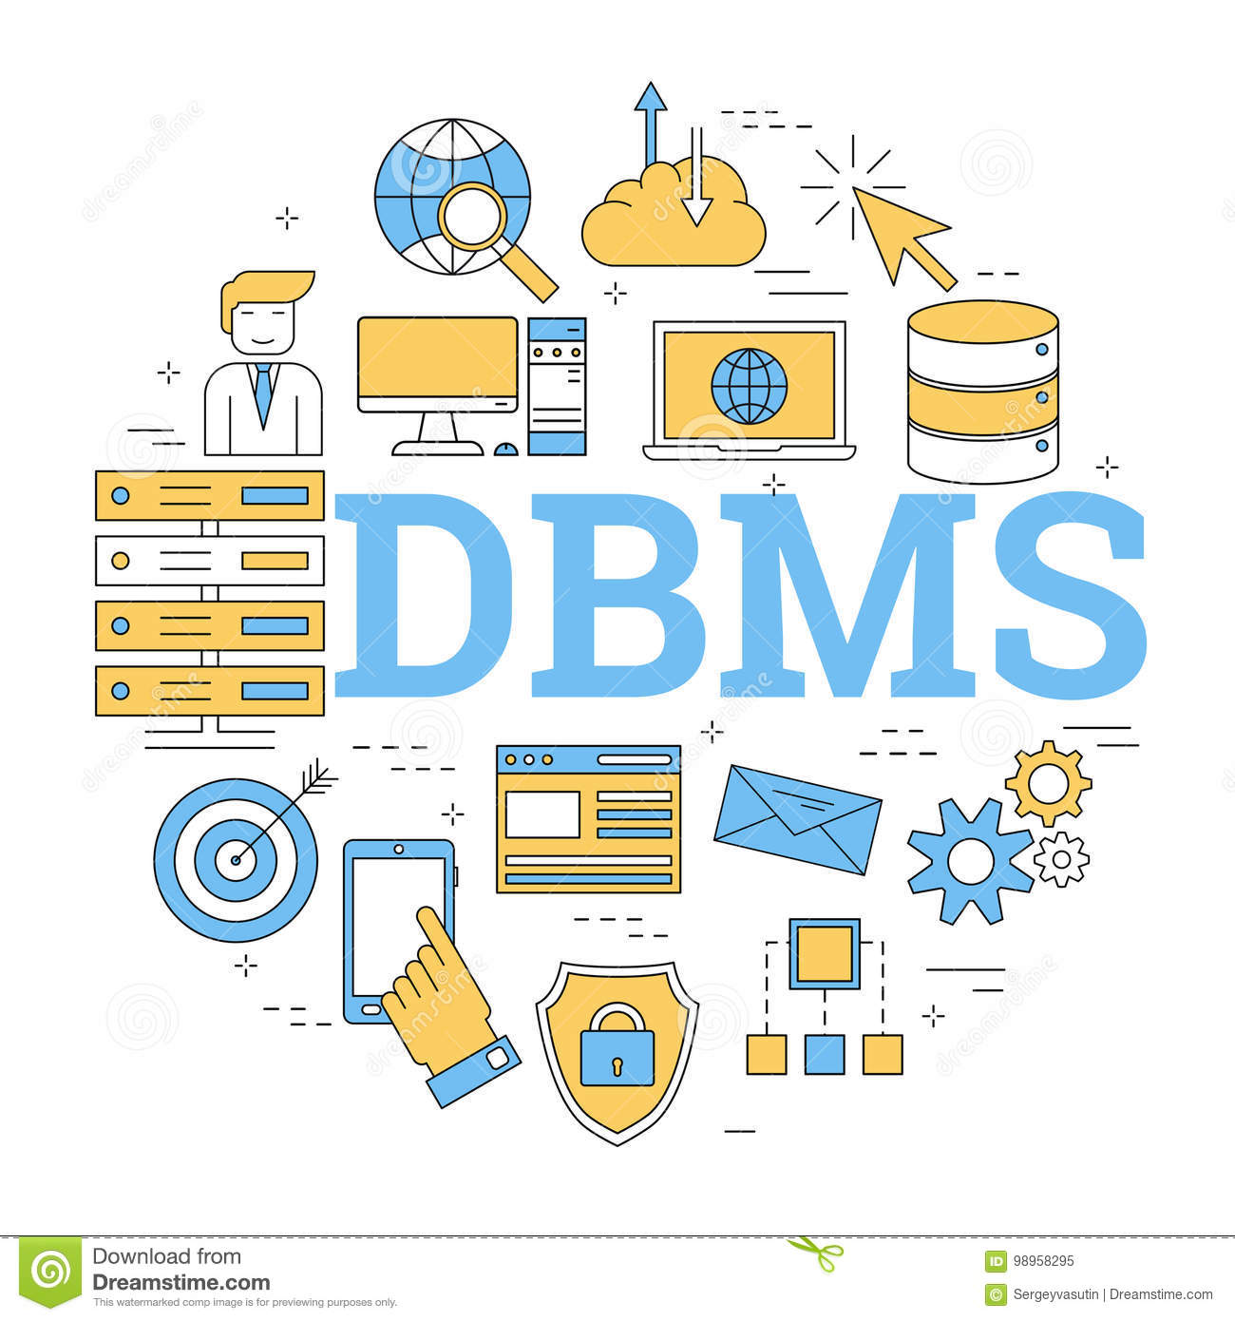
Database Management System
AKSHATHA A M
HARISHA R
RAHUL R NAVALLI
SHIVAKUMAR P
Date:26/11/2021

Slide 2

Overview of Oracle Database 12c and related products :
Oracle Database 12c is a relational database management system (RDBMS) designed for both on-premises and cloud uses and deployable on a choice of clustered or single servers.
It provides comprehensive features for managing data in transaction processing and content management applications.

Slide 3
Database Management System :
Database management system is a software which is used to manage the database. For example: MySQL, Oracle are a very popular commercial database which is used in different applications.
DBMS provides an interface to perform various operations like database creation, storing data in it, updating data, creating a table in the database and a lot more.
It provides protection and security to the database. In the case of multiple users, it also maintains data consistency.

Slide 4
Characteristics of DBMS :
It uses a digital repository established on a server to store and manage the information.
It can provide a clear and logical view of the process that manipulates data.
DBMS contains automatic backup and recovery procedures.
It contains ACID properties which maintain data in a healthy state in case of failure.
It can reduce the complex relationship between data.
It is used to support manipulation and processing of data.
It is used to provide security of data.
It can view the database from different viewpoints according to the requirements of the user.

Slide 5
Advantages of DBMS :
Controls database redundancy
Data sharing
Easily Maintenance
Reduce time
Backup
Multiple user interface

Slide 6
Disadvantages of DBMS :
Cost of Hardware and Software
Size
Complexity
Higher impact of failure

Slide 7

Introduction To SQL :
Structure Query Language(SQL) is a database query language used for storing and managing data in Relational DBMS.
SQL was the first commercial language introduced for E.F Codd's Relational model of database.
Today almost all RDBMS(MySql, Oracle, Infomix, Sybase, MS Access) use SQL as the standard database query language. SQL is used to perform all types of data operations in RDBMS

Slide 8
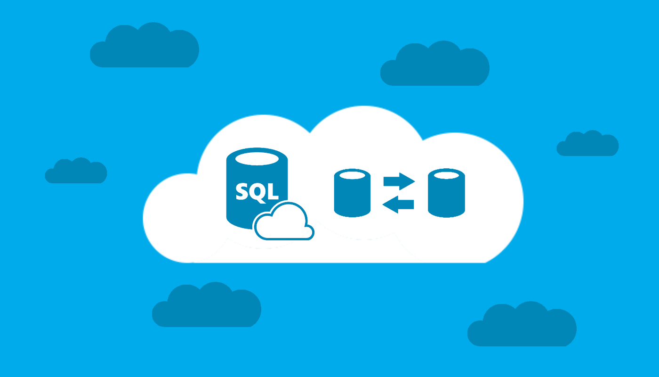
Advantages :
Faster Query Processing
No Coding Skills
Standardized Language
Portable
Interactive Language
Multiple data views

Slide 9
Applications of SQL :
SQL is used by developers and DBAs (Database Administrators) in writing Data Integration Scripts.
It is used to deal with analytical queries to analyze the data and get instincts from it.
Retrieving Information
Modification/Manipulation of data and database table such as Insertion, Deletion and Updation.

Slide 10

Oracle Database :
Oracle provides a range of industry-leading on-premises and cloud-based solutions to meet the data management requirements from small and medium sized businesses to large global enterprises.
Oracle Database is the world's most popular database. Available on cloud and on-premises platforms, Oracle Database 19c is the most recent long-term release, with an extended support window. Oracle Database 21c is the latest innovation release, initially available on Oracle cloud through Autonomous Database Free Tier and Database Cloud Service.

Slide 11
Oracle SQL Developer is a free graphical tool that enhances productivity and simplifies database development tasks. With SQL Developer, you can browse database objects, run SQL statements and SQL scripts, edit and debug PL/SQL statements, manipulate and export data, and view and create reports. You can connect to Oracle databases, and you can connect to selected third-party (non-Oracle) databases, view metadata and data, and migrate these databases to Oracle.
SQL Developer also integrates interfaces into several related technologies, including Oracle Data Miner, Oracle OLAP, Oracle Times Ten In-Memory Database, and SQL Developer Data Modeler (read-only).

Slide 12
SQL Select Statement :
Data Query Language (DQL) :
DQL is used to retrieve the data from the database.
SELECT :It is used to retrieve the data from the table and display it.
SELECT statements requires two clauses:
1.SELECT
2.FROM
syntax: SELECT Column_name
FROM Table_name;
example:
select *
from student;
(It retrieves all the details from the student table) .

Slide 13
SELECT statements have two optional clauses:
1.WHERE(conditions/expressions)
syntax:SELECT column1, column2....column FROM table_name WHERE CONDITION;
2.ORDER BY
SELECT column1, column2....column FROM table_name
WHERE CONDITION
ORDER BY column_name {ASC|DESC};
for example:
SELECT EMP_ID
FROM EMPLOYEE
WHERE EMP_NAME=‘SMITH’
ORDER BY EMP_ID

Slide 14
SELECT Capabilities :
SELECT statement has the following capabilities:
1.PROJECTION
2.SELECTION
3.JOINING
1.PROJECTION:
It is the process of retrieving the data by selecting only the columns is known as projection.
Example:
SELECT SID,SNAME
FROM STUDENT;
It retrieves student id and student names of all the students from the student table.

Slide 15
2.SELECTION:
It is the process of retrieving the data by selecting both the columns and rows. example:
SELECT ENAME
FROM EMPLOYEE
WHERE SAL >=1000;
It retrieves names of the employee getting salary more than or equal to 1000
3.JOINING:
It is the process of retrieving the data from the multiple tables simultaneously is know as joins
Types of joins: Inner join,left,right and full join, self join, equi and non-equi joins.
example: select * from employee
inner join department d
on e.dept_id=d.dept_id;

Slide 16
CONCATINATION OPERATOR:
This function is used to add two words or strings.
syntax: SELECT ‘string1’ + ‘ ‘ + ‘string2’;
example: SELECT ‘Good’ + ‘ ‘ + ‘morning’;
output: Good morning
DISTINCT KEYWORD:
It is used to remove the duplicate or repeated values from the result table
example:
SELECT DISTINCT EMP_NAME
FROM EMPLOYEE;

Slide 17
Data Manipulation Language (DML) :
A data manipulation language (DML) is a computer programming language used for adding (inserting), deleting, and modifying (updating) data in a database.
A DML is often a sublanguage of a broader database language such as SQL, with the DML comprising some of the operators in the language.
Data manipulation refers to the process of adjusting data to make it organized and easier to read
The SQL data manipulation language (DML) is used to query and modify database data.

Slide 18
SELECT – to query data in the database
The SELECT statement, or command, allows the user to extract data from tables, based on specific criteria. It is processed according to the following sequence:
INSERT – to insert data into a table
The INSERT statement adds rows to a table. In addition, INSERT specifies the table or view that data will be inserted into.
UPDATE – to update data in a table
The UPDATE statement changes data in existing rows either by adding new data or modifying existing data.
DELETE – to delete data from a table
The DELETE statement removes rows from a record set. DELETE names the table or view that holds the rows that will be deleted and only one table or row may be listed at a time. WHERE is a standard WHERE clause that limits the deletion to select records.

Slide 19
Data Definition Language (DDL) :
DDL refers to Data Definition Language , a subset of SQL statements that change the structure of the database schema in some way, typically by creating, deleting, or modifying schema objects such as databases, tables, and views.
DDL is a set of SQL commands used to create, modify, and delete database structures but not data.
Common DDL statements are CREATE, ALTER, and DROP.

Slide 20
List of DDL commands:
CREATE: This command is used to create the database or its objects (like table, index, function, views, store procedure, and triggers).
DROP: This command is used to delete objects from the database.
ALTER: This is used to alter the structure of the database.
TRUNCATE: This is used to remove all records from a table, including all spaces allocated for the records are removed.
COMMENT: This is used to add comments to the data dictionary.
RENAME: This is used to rename an object existing in the database.

Slide 21
THANK YOU

